Slide 1
JAVA WEB SERVICES
SOAP

Slide 2
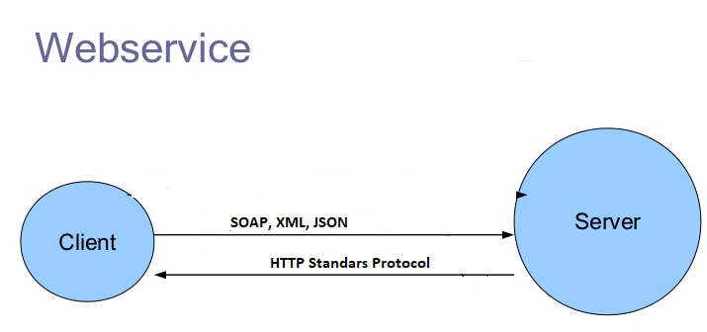
WHAT ARE WEB SERVICES
Webservices are client-server or consumer-provider applications that communicate on the network through the http protocol and and exchange messages or data as XML and in various other formats like JSON.

Slide 3
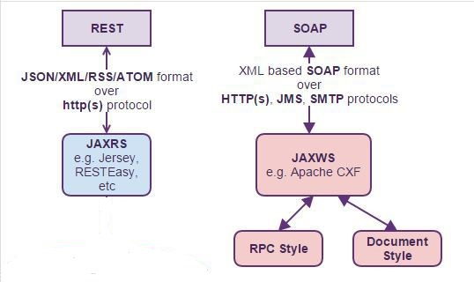
They are two different flavors or types of webservices.
  The first is the big webservices or the SOAP webservices which used XML based SOAP messages on the http post method.
    JAX-WS is the standard for implementing SOAP based webservices. JAX-WS stands for JAVA API for XML based webservices.
  Secondly, RESTFUL webservices which use http method to the full that is they use all the methods available in the http protocol.
    JAX-RS is a standard for implementing RESTFul webservices. JAX-RS stands for Java-API for restful webservices.

Slide 4
CHARACTERISTICS OF WEB SERVICES
Self-describing
Published, located, and accessed over the Internet
Interoperable
Lagunaje and platform neutral
Scalability

Slide 5
BASIC WEB SERVICES ELEMENTS
Service
Service Registry
Service Client
Messages
Inter Transport Protocol

Slide 6
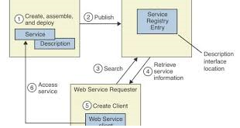
WEB SERVICE LIFE CYCLE
Create, assemble and deploy
Publish
Search
Retrieve Service information
Create cliente
Access Service

Slide 7
DEVELOPMENT APPROACHES
Code-first or bottom-up
  Write Java clases and the data POJOs represetanting the Service
  Use JAX-WS to generate the WSDL and XML schema types.
Contract-first or top-down
  Create WSDL and XML schemas manually
  Use JAX-WS tools to generate the java interface and the POJOs
Meet in the middle

Slide 8
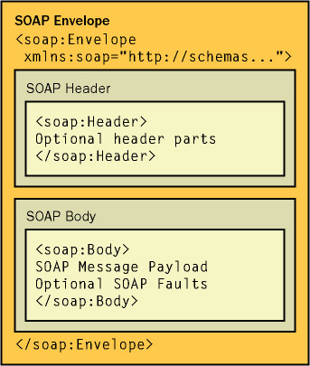
SOAP
Structure SOAP

Slide 9
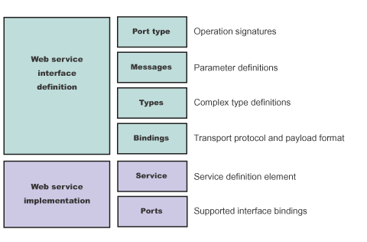
WSDL (WEBSERVICES DESCRIPTION LANGUAGE)
Structure WSDL

Slide 10
SAOP BINDINGS
RPC – Encoded
RPC – Literal
Document – Encoded
Document – Literal
Document – Literal - Wrapped

Slide 11
JAX-WS
@WebService
@SOAPBinding
@WebMethod
@WebParam
@WebResult
@WebFault

Slide 12
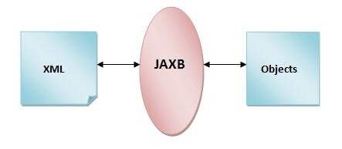
JAXB
JAXB Structure

